Slide 1
Unsupervised Learning
It is a machine learning technique in which the users do not need to supervise the model. Instead, it allows the model to work on its own to discover patterns and information that was previously undetected. It mainly deals with the unlabeled data.
Why unsupervised learning?
Unsupervised machine learning finds all kind of unknown patterns in data.
Unsupervised methods help you to find features which can be useful for categorization.
It is taken place in real time, so all the input data to be analyzed and labeled in the presence of learners.
It is easier to get unlabeled data from a computer than labeled data, which needs manual intervention.

Slide 2
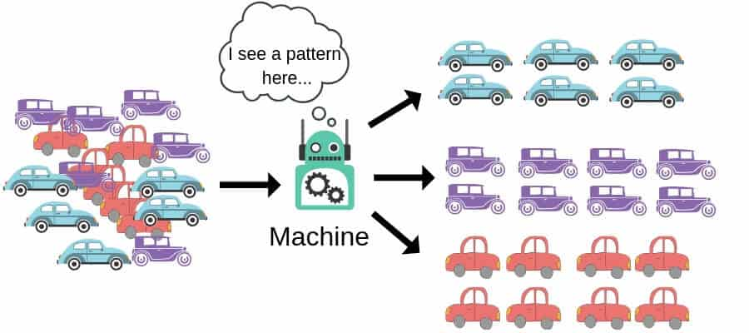
Diagram illustrating Unsupervised Learning

Slide 3
Types of Unsupervised Learning
Clustering - Clustering is an important concept when it comes to unsupervised learning. It mainly deals with finding a structure or pattern in a collection of uncategorized data. Unsupervised Learning Clustering algorithms will process your data and find natural clusters(groups) if they exist in the data.
Association – It allows one to establish associations amongst data objects inside large databases. This unsupervised technique is about discovering interesting relationships between variables in large databases. For example, people who buy a new home is most likely to buy new furniture. Another example is, groups of shopper based on their browsing and purchasing histories

Slide 4
Application areas of Unsupervised Learning Algorithms
recommendation systems
products segmentation
data set labeling
customer segmentation
similarity detection

Slide 5
Supervised vs. Unsupervised Machine Learning
Supervised Learning | Unsupervised Learning
Supervised learning algorithms are trained using labeled data. | Unsupervised learning algorithms are trained using unlabeled data.
Supervised learning model takes direct feedback to check if it is predicting correct output or not. | Unsupervised learning model does not take any feedback.
Supervised learning model predicts the output. | Unsupervised learning model finds the hidden patterns in data.
In supervised learning, input data is provided to the model along with the output. | In unsupervised learning, only input data is provided to the model.
The goal of supervised learning is to train the model so that it can predict the output when it is given new data. | The goal of unsupervised learning is to find the hidden patterns and useful insights from the unknown dataset.
Supervised learning needs supervision to train the model. | Unsupervised learning does not need any supervision to train the model.
Supervised learning can be categorized in Classification and Regression problems. | Unsupervised Learning can be classified in Clustering and Associations problems.

Slide 6
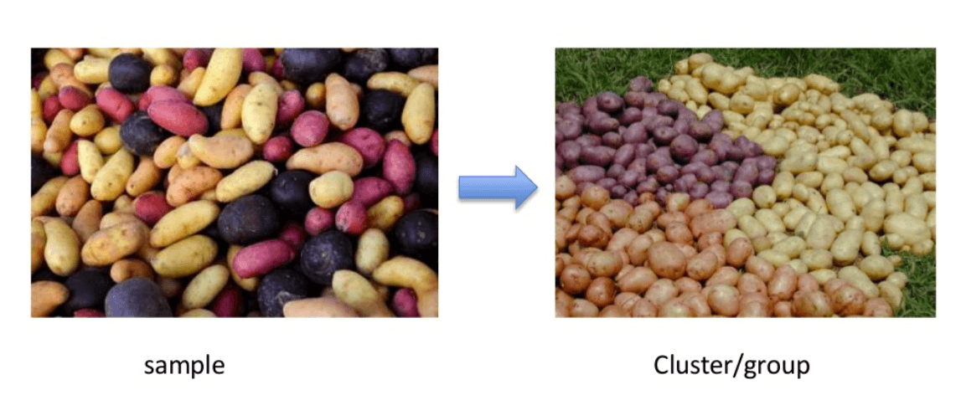
Clustering

Slide 7
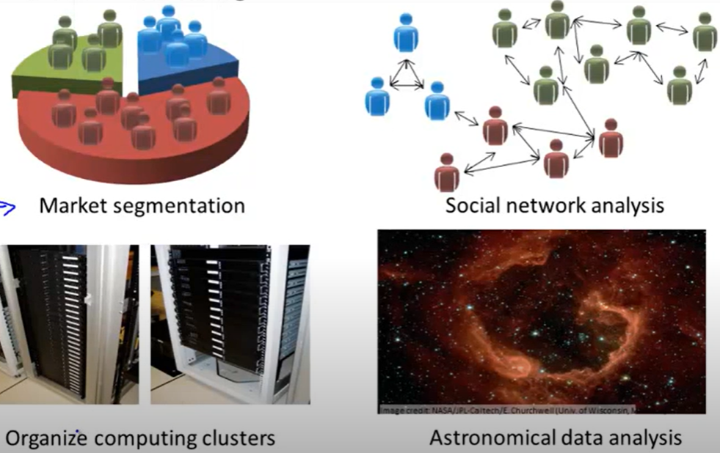
Applications of Clustering

Slide 8
K-Means Clustering
K means it is an iterative clustering algorithm which helps you to find the highest value for every iteration. Initially, the desired number of clusters are selected. In this clustering method, you need to cluster the data points into K groups. A larger K means smaller groups with more granularity in the same way. A lower K means larger groups with less granularity.
The output of the algorithm is a group of “labels.” It assigns data point to one of the k groups. In k-means clustering, each group is defined by creating a centroid for each group. The centroids are like the heart of the cluster, which captures the points closest to them and adds them to the cluster.

